Slide 1
C# Bootcamp
{ Module 1: Introduction, Data Types, Operators, Variables, Constants, Typecasts }
June 10, 2022

Slide 2
Module Objectives
Learn the steps of software development
Explore different programming methodologies
Become aware of how C# and .NET evolved and fit together
Learn why C# is being used today for software development
Explore the relationship between classes, objects, and types
Explore different data types (pre-defined, integral, floating-point, decimal, string, Boolean and user-define)
Work with constants, operators, typecast
Write assignment statements using arithmetic operators

Slide 3
Introduction to C#

Slide 4
Software Development Process
Introduction to C#
Programming is a process of problem solving
How do you start?
Number of different approaches, or methodologies
Successful problem solvers follow a methodical approach
Analyze the problem
Design a solution
Code the solution
Implement the code
Test and debug
Use an iterative approach

Slide 5
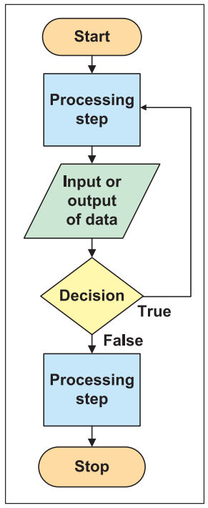
Programming Methodologies
Introduction to C#
Structured Procedural Programming
Emerged in the 1970s
Associated with top-down design
Analogy of building a house
is process oriented—focusing on the processes that data undergoes from input until meaningful output is produced
This approach is very effective for small stand-alone applications
Write each of the subprograms as separate functions or methods invoked by a main controlling function or module
Drawbacks
During software maintenance, programs are more difficult to maintain
Less opportunity to reuse code

Slide 6
Programming Methodologies
Introduction to C#
Object-oriented
Newer approach
Construct complex systems that model real-world entities
Facilitates designing components
Assumption is that the world contains a number of entities that can be identified and described
With object-oriented analysis, design, and programming, the focus is on determining the objects you want to manipulate rather than the processes or logic required to manipulate the data.

Slide 7
Programming Methodologies
Introduction to C#
Abstraction
Through abstracting, determine attributes (data) and behaviors (processes on the data) of the entities
Encapsulation
Combine attributes and behaviors to form a class
Polymorphism
Methods of parent and subclasses can have the same name, but offer different functionality
Invoke methods of the same name on objects of different classes and have the correct method executed

Slide 8
The Evolution of C# and .NET
Introduction to C#
1940s: Programmers toggled switches on the front of computers
1950s: Assembly languages replaced the binary notation
Late 1950s: High-level languages came into existence
Today: More than 2,000 high-level languages
Noteworthy high-level programming languages are C, C++, Visual Basic, Java, and C#

Slide 9
C#
Introduction to C#
One of the newest programming languages
Conforms closely to C and C++
Has the rapid graphical user interface (GUI) features of previous versions of Visual Basic
Has the added power of C++
Has the object-oriented class libraries similar to Java

Slide 10
.Net
Introduction to C#
Not an operating system
An environment in which programs run
Resides at a layer between operating system and other applications
Offers multilanguage independence
One application can be written in more than one language
Includes over 2,500 reusable types (classes)
Enables creation of dynamic Web pages and Web services
Scalable component development

Slide 11
C# Relationship to .NET
Introduction to C#
Many compilers targeting the .NET platform are available
C# was used most heavily for development of the .NET Framework class libraries
C#, in conjunction with the .NET Framework classes, offers an exciting vehicle to incorporate and use emerging Web standards
C# is object-oriented
In 2001, the European Computer Manufacturers Association (ECMA) General Assembly ratified C# and its common language infrastructure (CLI) specifications into international standards

Slide 12
Types of Applications Developed with C#
Introduction to C#
Web applications
Windows graphical user interface (GUI) applications
Console-based applications
Class libraries and stand-alone components (.dlls), smart device applications, and services can also be created

Slide 13
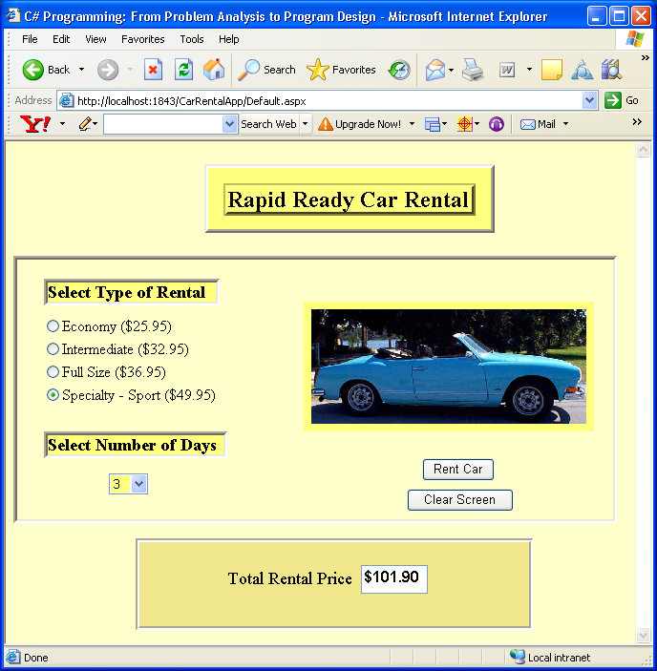
Web Applications
Introduction to C#
C# was designed with the Internet applications in mind
Can quickly build applications that run on the Web with C#
Using Web Forms: part of ASP.NET
Web Application written using C#

Slide 14
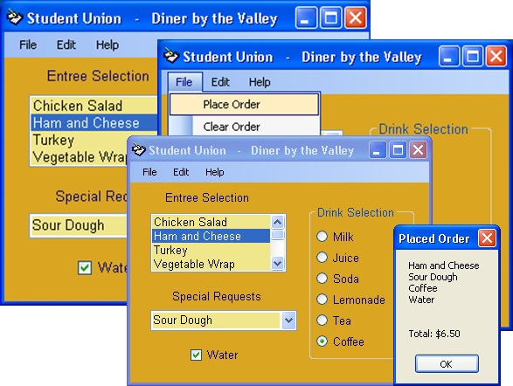
Windows Applications
Introduction to C#
Applications designed for the desktop
Designed for a single platform
Use classes from System.Windows.Form
Applications can include menus, pictures, drop-down controls, buttons, textboxes, and labels
Use drag-and-drop feature of Visual Studio
Windows Application written using C#

Slide 15
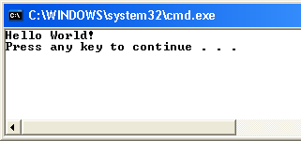
Console Applications
Introduction to C#
Normally send requests to the operating system
Display text on the command console
Easiest to create
Simplest approach to learning software development
Minimal overhead for input and output of data
Output from the First C# Program

Slide 16
Elements of a C# Program

Slide 17
Comments
Elements of a C# Program
line 1 // This is traditionally the first program written.
Like making a note to yourself or readers of your program
Not considered instructions to the computer
Not checked for rule violations
Document what the program statements are doing
Make the code more readable
Three types of commenting syntax
Inline comments
Multiline comments
XML documentation comments

Slide 18
Inline Comments
Elements of a C# Program
line 1 // This is traditionally the first program written.
Indicated by two forward slashes (//)
Considered a one-line comment
Everything to the right of the slashes ignored by the compiler
Carriage return (Enter) ends the comment

Slide 19
Multiline Comments
Elements of a C# Program
Forward slash followed by an asterisk (/*) marks the beginning
Opposite pattern (*/) marks the end
Also called block comments
/* This is the beginning of a block multiline comment. It can go on for several lines or just be on a single line. No additional symbols are needed after the beginning two characters. Notice there is no space placed between the two characters. To end the comment, use the following symbols. */

Slide 20
XML Documentation Comments
Elements of a C# Program
Extensible Markup Language (XML)
Markup language that provides a format for describing data using tags
Similar to HTML tags
Three forward slashes (///) mark beginning of comment
Advanced documentation technique used for XML-style comments
Compiler generates XML documentation from them
/// <summary>
/// This property always returns a value.
/// </summary>

Slide 21
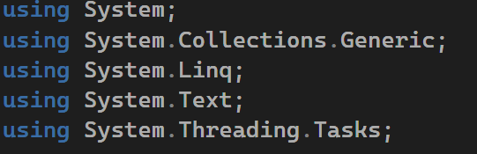
using Directive
Elements of a C# Program
Permits use of classes found in specific namespaces without having to qualify them
Framework class library
Over 2,000 classes included
Syntax
using namespaceIdentifier;

Slide 22
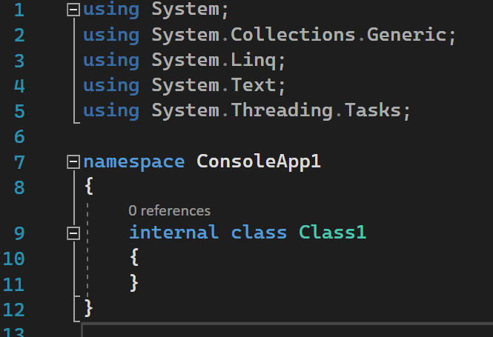
namespace
Elements of a C# Program
Predefined namespace (System)– part of .NET FCL
Namespaces provide scope for the names defined within the group
Groups semantically related types under a single umbrella
System: most important and frequently used namespace
Can define your own namespace
Each namespace enclosed in curly braces: { }
User defined namespace
Output from the First C# Program
Body of user defined namespace

Slide 23
class
Elements of a C# Program
Building block of object-oriented program
Everything in C# is designed around a class
Every program must have at least one class
Classes define a category, or type, of object
Every class is named
Define class members within curly braces
Include data members
Stores values associated with the state of the class
Include method members
Performs some behavior of the class
Can call predefined classes’ methods
Main( )
Output from the First C# Program
User defined class

Slide 24
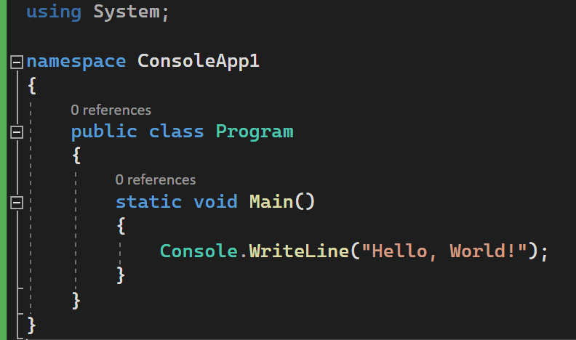
Main()
Elements of a C# Program
“Entry point” for all applications
Where the program begins execution
Execution ends after last statement in Main( )
Can be placed anywhere inside the class definition
Applications must have one Main( ) method
Begins with uppercase character
Enclosed in curly braces
Output from the First C# Program
Main() method body

Slide 25
Method Calls
Elements of a C# Program
Program statements
WriteLine( ) → member of the Console class
Main( ) invoking WriteLine( ) method
Member of Console class
Method call ends in semicolon

Slide 26
Program Statements
Elements of a C# Program
Write ( ) → Member of Console class
Argument(s) enclosed in double quotes inside ( )
“Hello World!” is the method’s argument
“Hello World!” is string argument
string of characters
May be called with or without arguments
Console.WriteLine( );
Console.WriteLine(“WriteLine( ) is a method.”);
Console.Write(“Main( ) is a method.”);

Slide 27
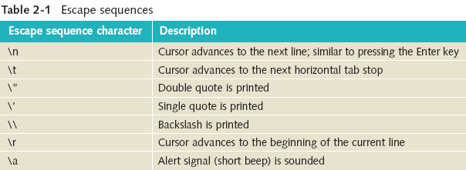
Program Statements
Elements of a C# Program
Read( ) accepts one character from the input device
ReadLine( ) accepts string of characters from the input device
Until the enter key is pressed
Write( ) does not automatically advance to next line
Write(“An example\n”);
Same as WriteLine(“An example”);
Includes special escape sequences
Special characters enclosed in double quotes

Slide 28
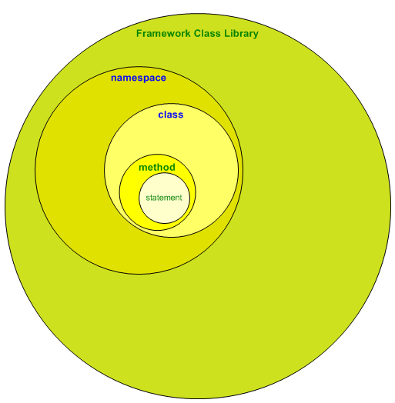
C# Elements
Elements of a C# Program
Relationship among C# elements

Slide 29
Create Console Application

Slide 30
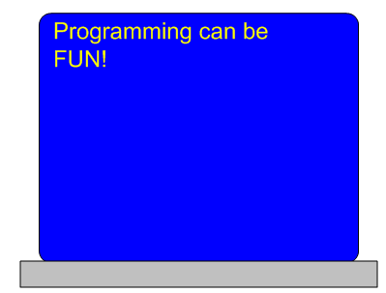
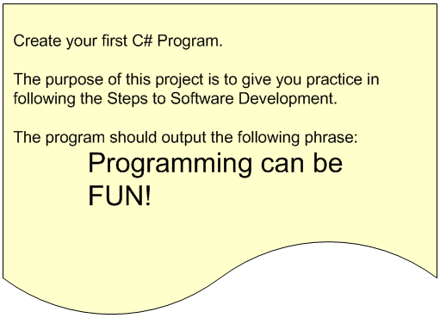
Programming Message Example
Create Console Application

Slide 31
Data Types and Expressions

Slide 32
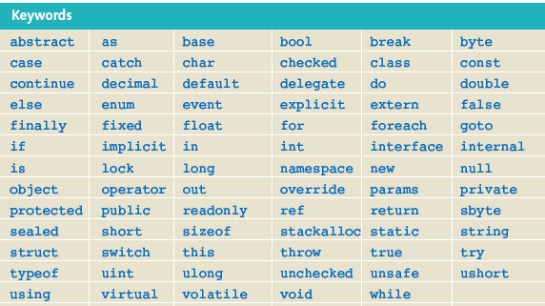
Identifier
Data Types and Expressions
Name
Rules for creating an identifier
Combination of alphabetic characters (a-z and A-Z), numeric digits (0-9), and the underscore
First character in the name may not be numeric
No embedded spaces – concatenate (append) words together
Keywords cannot be used
Use the case of the character to your advantage
Be descriptive with meaningful names
Reserved Words in C#

Slide 33
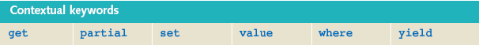
Reserved Words in C#
Data Types and Expressions
Contextual keywords
As powerful as regular keywords
Contextual keywords have special meaning only when used in a specific context; other times they can be used as identifiers

Slide 34
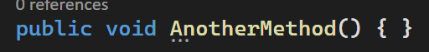
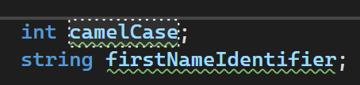
Naming Conventions
Data Types and Expressions
Pascal case
First letter of each word capitalized
Class, method, namespace, and properties identifiers
Camel case
Hungarian notation
First letter of identifier lowercase; first letter of subsequent concatenated words capitalized
Variables and objects

Slide 35
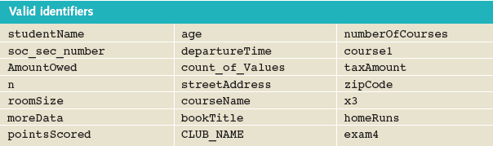
Examples of Valid Names (Identifiers)
Data Types and Expressions

Slide 36
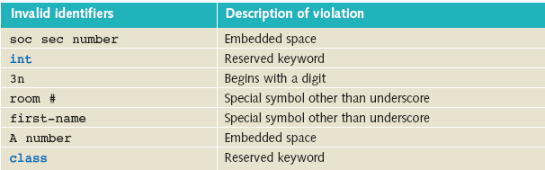
Examples of Invalid Names (Identifiers)
Data Types and Expressions

Slide 37
Variables
Data Types and Expressions
Area in computer memory where a value of a particular data type can be stored
Declare a variable
Allocate memory
Syntax --- type identifier;
Compile-time initialization
Initialize a variable when it is declared
Syntax --- type identifier = expression;

Slide 38
Types, Classes, and Objects
Data Types and Expressions
Type
C# has more than one type of number
int type is a whole number
floating-point types can have a fractional portion
Types are actually implemented through classes
One-to-one correspondence between a class and a type
Simple data type such as int, implemented as a class
Instance of a class → object
A class includes more than just data
Encapsulation → packaging of data and behaviors into a single or unit → class

Slide 39
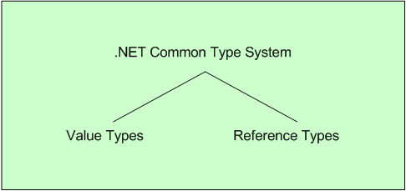
Predefined Data Types
Data Types and Expressions
Common Type System (CTS)
Divided into two major categories

Slide 40
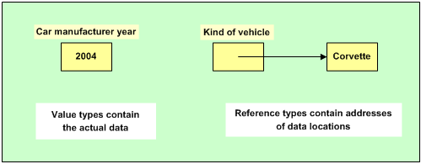
Value and Reference Types
Data Types and Expressions

Slide 41
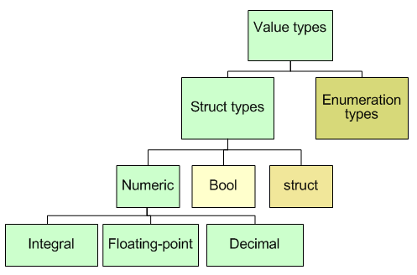
Value Types
Data Types and Expressions
Fundamental or primitive data types

Slide 42
Reference Types
Data Types and Expressions
Represents a string of Unicode characters
Strings
string studentName;
string courseName = “C# Bootcamp”;
string twoLines = “Line1\nLine2”;

Slide 43
Making Data Constant
Data Types and Expressions
Add the keyword const to a declaration
Value cannot be changed
Standard naming convention
Syntax
const type identifier = expression;
const double TAX_RATE = 0.0675;
const int SPEED = 70;
const char HIGHEST_GRADE = ‘A’;

Slide 44
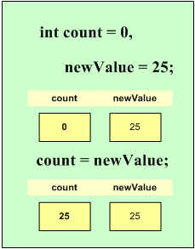
Assignment Statements
Data Types and Expressions
Used to change the value of the variable
Assignment operator (=)
Syntax
variable = expression;
Expression can be:
Another variable
Compatible literal value
Mathematical equation
Call to a method that returns a compatible value
Combination of one or more items in this list

Slide 45
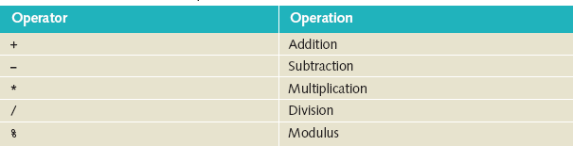
Arithmetic Operations
Data Types and Expressions
Simplest form of an assignment statement
resultVariable = operand1 operator operand2;
Readability
Space before and after every operator

Slide 46
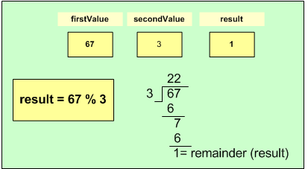
Basic Arithmetic Operations
Data Types and Expressions
Modulus operator with negative values
Sign of the dividend determines the result
-3 % 5 = -3; 5 % -3 = 2; -5 % -3 = -3;

Slide 47
Basic Arithmetic Operations
Data Types and Expressions
Plus (+) with string Identifiers
Concatenates operand2 onto end of operand1
string result;
string fullName;
string firstName = “Rochelle”;
string lastName = “Howard”;
fullName = firstName + “ “ + lastName;

Slide 48
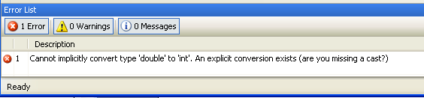
Mixed Expressions
Data Types and Expressions
Implicit type coercion
Changes int data type into a double
No implicit conversion from double to int

Slide 49
Mixed Expressions
Data Types and Expressions
Explicit type coercion
Cast
(type) expression
examAverage = (exam1 + exam2 + exam3) / (double) count;
int value1 = 0, anotherNumber = 75;
double value2 = 100.99, anotherDouble = 100;
value1 = (int)value2; // value1 = 100
value2 = (double)anotherNumber; // value2 = 75.0

Slide 50
Demo

Slide 51
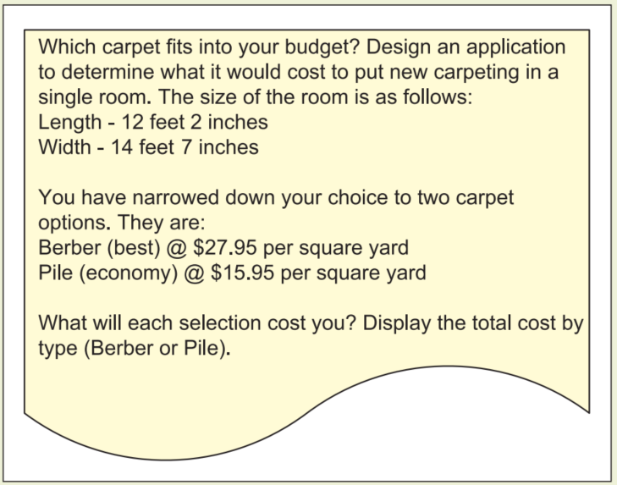
Problem Statement
Demo

Slide 52



Questions?

Slide 53
Thank you

